Slide 1


`

Slide 2



DEVELOPMENT SERVICES
TRADING & AGENCY REPRESENTATION
CIVIL CONSTRUCTION, AIRCONDITIONING, ELECTRICAL & MAINTENANCE SERVICES

Slide 3


CORROSION ENGINEERING , CIVIL CONSTRUCTION, INSULATION & REFRACTORY , SCAFFOLDING AND ELECTRO MECHANICAL.
SUPPLY & SERVICE TO OIL & GAS INDUSTRY

Slide 4
AL GAZAL OPTICIANS
TAKARA AUTHENTIC JAPANESE RESTAURANT

Slide 5
INTRODUCTION
Development Services (DS) was established in 1978 as a trading company for the supply of equipment to the Power Industry in the Sultanate of Oman. Over the years, DS has diversified its business activities to include Oil & Gas, Water, Aviation and Project Industrial Supplies. DS also provides market Intelligence for its International Partners.

Slide 6
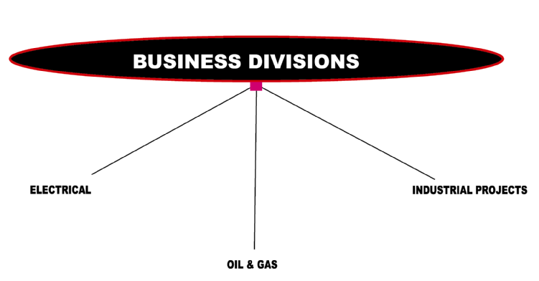

Slide 7
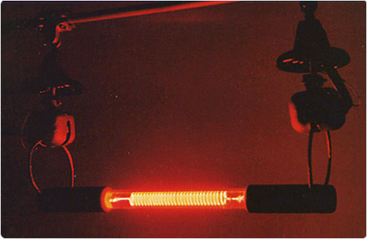
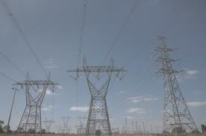
EL ELECTRICAL DIVISION
Development Services is one of the leading suppliers of electrical equipment for the High Voltage Systems. Electrical division is specialized in supply of electrical equipment to Power, Oil & Gas Industry.
DS exclusively or on a Project Basis Looks after the interest of Several International companies.

Slide 8
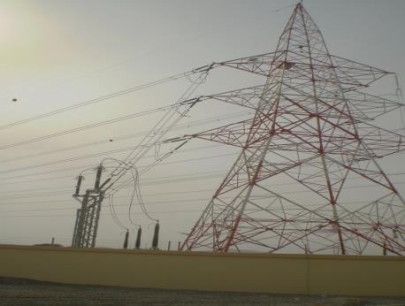
OUR MAJOR CLIENTS
Oman Electricity Transmission Company SAOC
Muscat Electricity Distribution Company SAOC
Mazoon Electricity Company SAOC
Majan Electricity Company SAOC
Rural Area Electricity Companies SAOC
Dhofar Power Company SAOC
Local & International EPC Contractors.

Slide 9
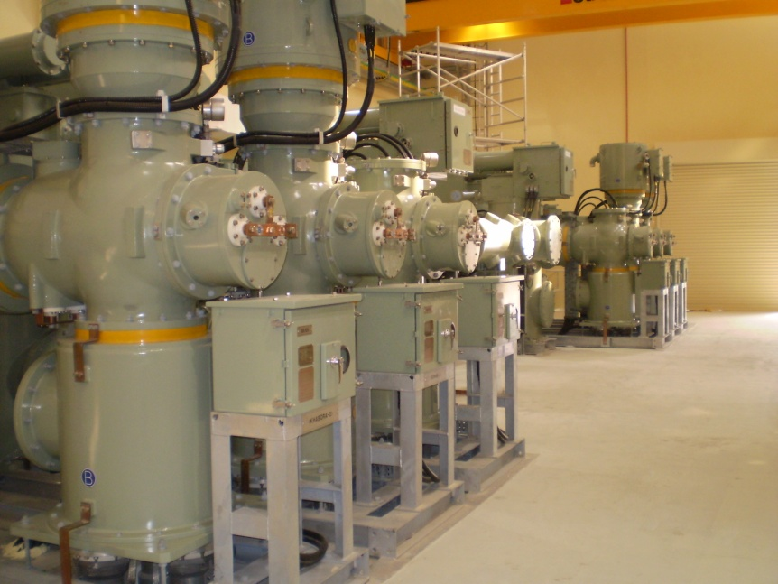
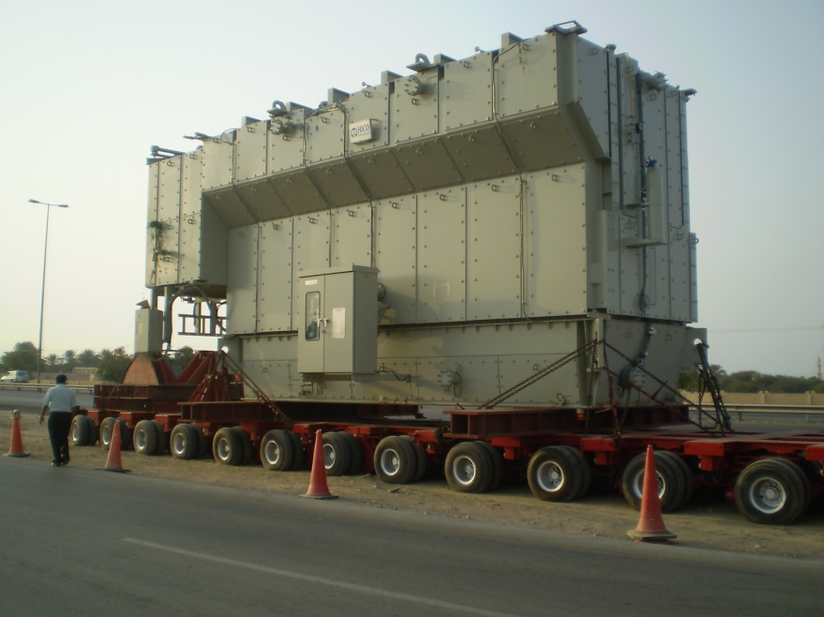
Some of our Principals are:-
Taihan Fiber Optic Co. Korea - OPGW
Taihan Electric Wire Company, Korea - Power Cables
Tridelta GMBH, Germany - Surge Arrestors
NGK Insulators Japan - Insulators upto400KV
Shin Seong Elrex Corp., Korea - Air Warning systems, Tower
Marking Lamps
Dalekovod, Croatia - OHL Hardwares

Slide 10
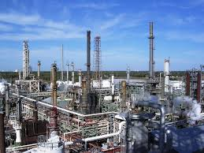
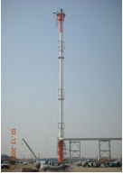
MECHANICAL DIVISION
Mechanical Division is specialized in supplying equipment and service to the upstream and downstream Oil & Gas Industry, Power Sector, Water & Wastewater Sector and other industrial units.

Slide 11
We are registered suppliers to the following:
Petroleum Development of Oman (PDO).
OQ Group Oman
Occidental of Oman
CCED
Public Authority for Electricity & Water
Oman Wastewater Company
Haya Water
OOCEP
Daleel Petroleum

Slide 12
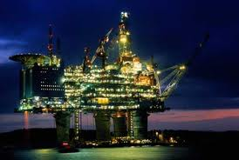
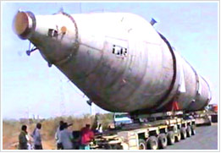
Some of our Principals for Oil & Gas industry:
Hanhwa Engg. & Const. Corp., Korea - EPC Contractors
Posco Engineering, Korea - EPC Contractors
CMI, Belgium - Boilers
Combustion System
Titanium Fabrication Corporation, USA - Titanium Heat Exchangers,
Vessels
Innovative Steam Technologies- Canada - HRSG/Boilers

Slide 13


Some of our Principals for Oil & Gas industry:
ZEECO, U.S.A - Flares, Burners
MAN Industries, India - C.S. Pipes
Innovative Steam Technologies- Canada - HRSG/Boilers
Rolls Royce Eng. Plc. - Gas Turbine Servicing
-

Slide 14
INDUSTRIAL PROJECTS DIVISION
We have established exclusive agency agreements with International Manufacturers for forth coming Industrial Projects in Oman and also well specialized in identifying those forth coming projects. The division provides market intelligence for its international partner in supplying equipment and providing service for green field projects.

Slide 15
Petrochemical Project
Some of our Principals are:-
Hanhwa Engineering & Constr. Corp., Korea - E.P.C. Contractors for
Hydro Carbon Projects
Innovative Steam Technologies- Canada- HRSG
TIFAB, U.S.A. - Titanium Heat Exchanger, Vessels etc.
CMI, Belgium - Industrial Boiler
M.S.A., Czech Republic - Industrial Valves
Thermo Electra, Netherlands - Temperature Instrument

Slide 16
Sewage Plants
Some of our Principals are:-
Hyundai Rotem Company – Korea - Waste Water Treatment Plant
Royce Technologies – U.S.A. - Monitoring & Control
Instruments for Waste Water Plants.

Slide 17
Aviation & Transport Industry
Some of our Principals are:-
REEL S.A.S. France - Aircraft Docking System
Caren – Spain - Hangar Door

Slide 18
MAJOR PROJECT REFERENCE
Equipment/ Project | Client | Our Principal | Approx. Value USD
EDC/ Caustic Soda Plant | Oswal Industries | Hanwha E& C, Korea | 550 Million
Sewage Treatment Plant | Haya Water | Hyundai Rotem, Korea | 260 Million
HRSG | Mukhaizna Project | NEM - Germany | 45 Million
Boilers | Sohar Fertlisers | NEM - Germany | 6 Million
Power Cables (Various Projects) | OETC | Taihan Electric Wire Co. Ltd., Korea | 20 Million
Boilers | Sohar Refinery | Standard Fasel Lentjes - Netherlands | 12.2 Million
Transformers ( Various Projects) | OETC & IWPP PROJECTS | Hyosung Corp. - Korea | 10 Million

Slide 19
MAJOR PROJECT REFERENCE
Equipment/ Project | Client | Our Principal | Approx. Value USD
Titanium Heat Exchanger | Oman Refineries & Petrochemicals Co. | TiFAB. - USA | 4.5 Million
Gas Insulated Switchgear ( Various Projects) | OETC | Taihan Cables - Korea | 15 Million
Boilers | Fertiliser Project | NEM - Netherlands | 12 Million
Acid Gas Incinerator | Gas Sweetening Project | Zeeco Inc. – U.S.A | 1.5 Million
Aviation Warning Systems | OETC | Shin Seong Elrex, Korea | 1.5 Million
Motors for Pump Upgrade | Oman Refineries & Petrochemicals Co. | Flowserve, Germany | .66 Million

Slide 20

HEALTH SAFETY AND ENVIRONMENT
Development Services Recognizes
its Legal, Moral, and Economic responsibilities towards
Health of its own and Subcontractor’s Employees
Safety of Men, Material and Operations
Protection of the Environment

Slide 21

THANK YOU
WE ARE READY TO SUPPORT YOU

Slide 22

CONTACT DETAILS
Development Services
P.O. Box 2463, Ruwi 112
Wadi Kabir, Way 6527, Bldg. 2330
Next to Photocenter
Sultanate of Oman
Tel: 24814081, 24815021, 24815091
Fax: 24816017
Email: develop@dsoman.com

